Slide 1
Number System
Lecture 03

Slide 2
Memory Units
Memory unit is the amount of data that can be stored in the storage unit. This storage capacity is expressed in terms of Bytes.
S.No. | Unit & Description
1 | Bit (Binary Digit) A binary digit is logical 0 and 1 representing a passive or an active state of a component in an electric circuit.
2 | Nibble A group of 4 bits is called nibble.
3 | Byte A group of 8 bits is called byte. A byte is the smallest unit, which can represent a data item or a character.
4 | Word A computer word, like a byte, is a group of fixed number of bits processed as a unit, which varies from computer to computer but is fixed for each computer. The length of a computer word is called word-size or word length. It may be as small as 8 bits or may be as long as 96 bits. A computer stores the information in the form of computer words.

Slide 3
Memory Units
The following table lists some higher storage unit
S.No. | Unit & Description
1 | Kilobyte (KB) 1 KB = 1024 Bytes
2 | Megabyte (MB) 1 MB = 1024 KB
3 | GigaByte (GB) 1 GB = 1024 MB
4 | TeraByte (TB) 1 TB = 1024 GB
5 | PetaByte (PB) 1 PB = 1024 TB

Slide 4
Different Number Systems
There four main types of number system. The types are:
Decimal System
Binary System
Octal System
Hexadecimal System.

Slide 5
Decimal System
In decimal system the base is 10. Base mean the number produced in this can’t become greater than its base e.g (0, 1, 2, 3, 4, 5, 6, 7, 8 and 9). Decimal system is used in daily life for counting.
For example: (5281)₁₀ = 5281 is decimal number:

Slide 6
Binary System
In decimal system the base is 2. Base mean the number produced in this can’t become greater than its base e.g (0 and 1). Binary system is used in computers.
The computer does not have a large number of symbols for representing data. It has only two, 0 and 1 (called binary digits or bits). These correspond to the two electronic or magnetic states used in computer circuits and storage.
For example : (101011)₂ is a binary number:

Slide 7
Octal System
In octal system the base is 8. Base mean the number produced in this can’t become greater than its base e.g (0 and 7). Octal system is used in computers.
For example : (235)₈ is a Octal number:

Slide 8
Hexadecimal System
In Hexadecimal system the base is 16. Base mean the number produced in this can’t become greater than its base e.g (0 and 15). Hexadecimal system is used in computers to store memory address.
From 0-9 each number is one digit while from 10-15 all numbers are 2 digits, so computer represent these double digit number with one alphabet give below.
Hexadecimal numbers have either an 0x prefix, a 16 subscript or an h suffix.
For example : (2F3A)₁₆ is a Hexadecimal number:
0 | 1 | 2 | 3 | 4 | 5 | 6 | 7 | 8 | 9 | 10 | 11 | 12 | 13 | 14 | 15
0 | 1 | 2 | 3 | 4 | 5 | 6 | 7 | 8 | 9 | A | B | C | D | E | F

Slide 9
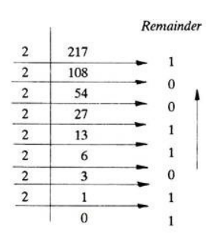
Decimal to Binary Conversion
Convert the following Decimal numbers into Binary numbers:
Example: 217

Slide 10

Decimal to Octal Conversion
Convert the following Decimal numbers into Octal numbers:
Example:
(331)₈

Slide 11
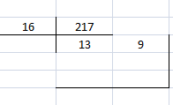
Decimal to Hexadecimal Conversion
Convert the following Decimal numbers into Hexadecimal numbers:
Example:
13- 9
(D9)₁₆

Slide 12
Binary to Decimal Conversion
Convert the following Binary numbers into Decimal numbers?
For example: 1011
(1 x 2³) + (0 x 2²) + (1 x 2¹) + (1 x 2⁰)
= 8 + 0 + 2 + 1 = 11.

Slide 13
Octal to Decimal Conversion
Convert the following Octal numbers into Decimal numbers?
For example: 237
(2 x 8²) + (3 x 8¹) + (7 x 8⁰)
= 128 + 24 + 7 = 159.

Slide 14
Hexadecimal to Decimal Conversion
Convert the following Hexadecimal numbers into Decimal numbers?
Example: 2F1A
=2x16³ + Fx16² + 1x16¹ + Ax16⁰
= 2x 4096 +15x256 +16 +10x1
= 8192 +3840 +16 + 10
= 12058

Slide 15
Non-Decimal to Non-Decimal Conversion
If we are converting a non-decimal to a non-decimal number. The rules will be as following.
Convert the non-decimal to decimal number
Convert that decimal to a non-decimal number.

Slide 16
Exercise 1(Decimal 2 B,O, H)
Decimal | Binary | Octal | Hexadecimal
29
93
127
493
956

Slide 17
Exercise 2(Convert to Decimal)
Binary | Octal | Hexadecimal | Decimal
101101
111011
 | 76231
 | 26584
 |  | FF3Dh
 |  | 0x68
 |  | 0x2BB
 |  | 0x9E3

Slide 18
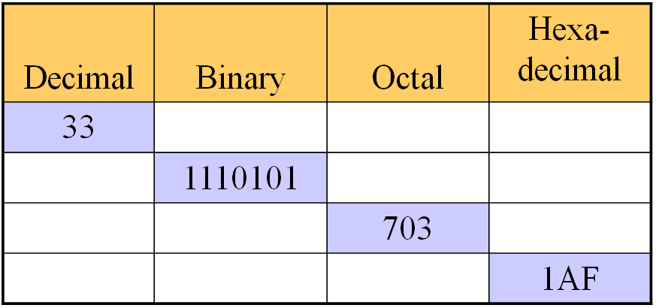
Exercise 3

Slide 19
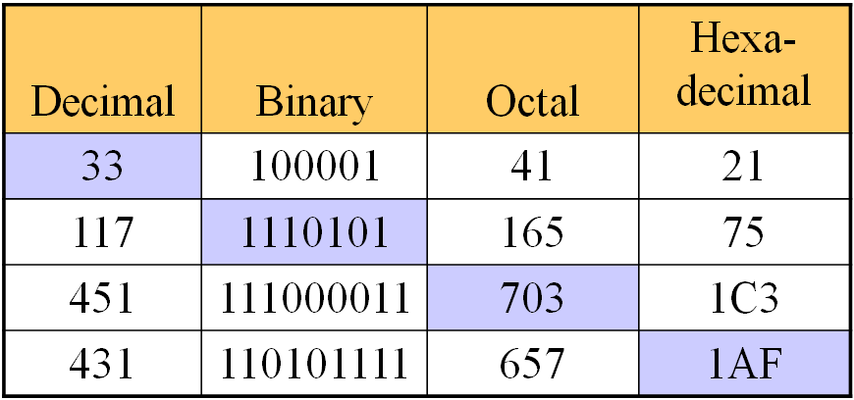
Exercise - solution

Slide 20
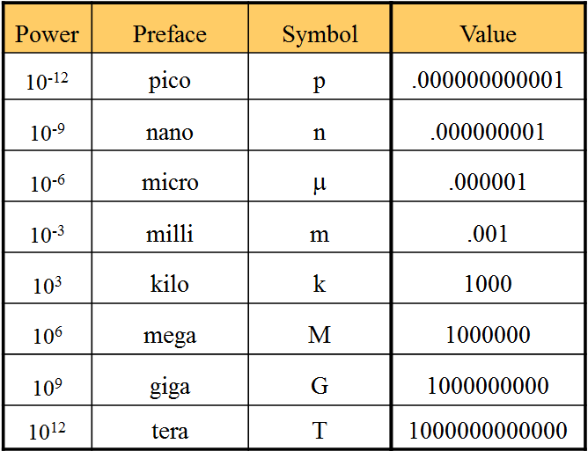
Common Powers
Base 10

Slide 21
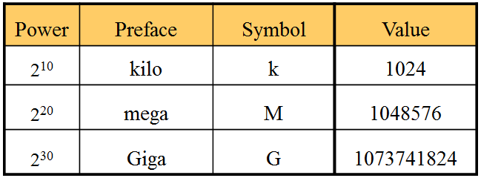
Common Powers
Base 2

